Slide 1
Maine Offshore Wind Port Development
By: Matt Burns, Maine Port Authority

Slide 2
What has Maine been doing?
Research&Innovation – Monhegan, Research Array
Policy&Legislation – LD 336
Partnerships – UK, UMaine
Planning and stakeholder engagement - Roadmap

Slide 3
Maine Climate/Clean Energy Targets
Reduce GHG Emissions 45% below 1990 levels by 2030. 80% by 2050.
Renewable portfolio standard requirements 80% by 2030, 100% by 2050. Achieve carbon neutrality by 2045.
Meeting carbon requirements requires electrification of transportation and residential heating. These make up more than 70% of emissions.

Slide 4
Why is Maine pursuing OSW?
Maine set its first OSW targets in 2009. 5GW by 2030. This needs to be updated. National target is 30GW by 2030.
OSW is an important component of the state's long term energy needs.
OSW in Maine builds from UMaine's decade of R&D. Maine is the first state to receive energy from OSW. 2019 1/8th scale project.
An opportunity for Maine to: Fight climate change, Harness renewable energy, Create jobs/economic growth, Sustain Maine's maritime heritage
Maine ingenuity patented a floating hull design that is specifically designed to be built in state.

Slide 5
Maine OSW Roadmap
Roadmap has been running nearly a year and will conclude in December 2022.
$2.1mm grant from EDA in 2020
96 members of WG's and AC
50+ meetings from July 2021-April 2022
Technical studies

Slide 6
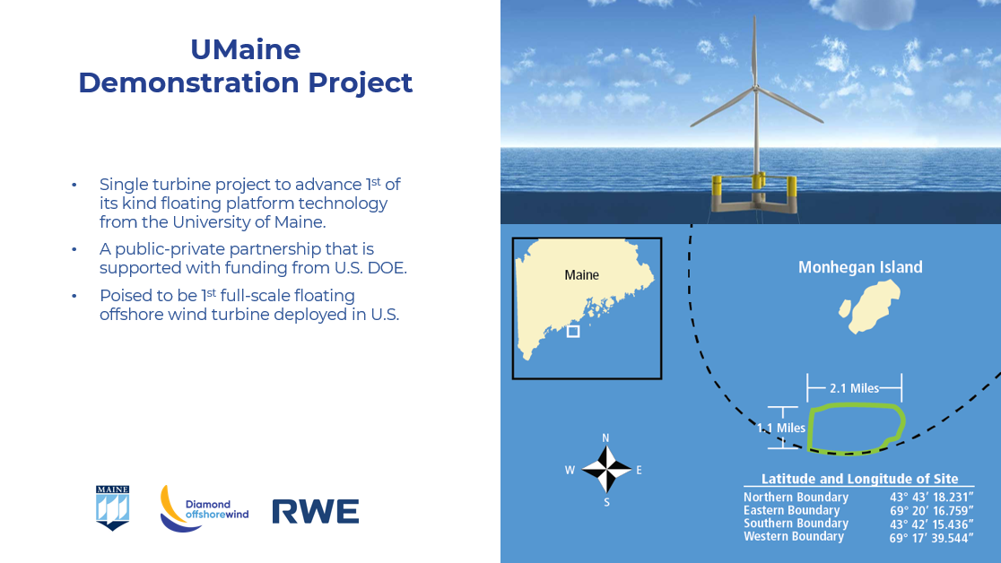

Slide 7
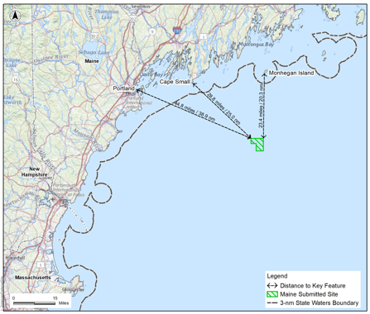
Maine Research Array
Maine is pursuing floating offshore wind technology with an application to the Bureau of Ocean Energy Management (BOEM) for a research lease in the Gulf of Maine.
The commercial leasing process is happening on a parallel track. Expect commercial lease sale in GoM in 2024.
Located approximately 30m from the mainland.
12 turbines or fewer.
Power potential is 144 MW
Proposed lease area is 15.2 square miles
State partners are Umaine and New England Aqua Ventus.
A port facility is required to construct the floating foundations and install the wind turbines to the foundations.

Slide 8
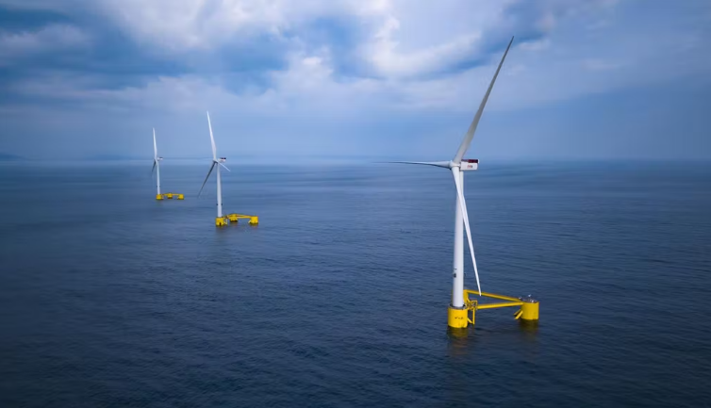

Slide 9
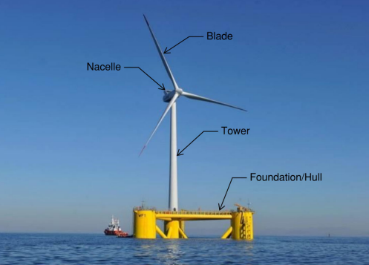
What makes up a floating OSW turbine?
Nacelle – The outer covering that houses all the energy generating components including the gearbox and drivetrain.
Tower – Column that elevates the nacelle to the proper hub height to capture the optimal wind speeds. Towers typically come in two to three sections.
Blades – Used to capture the wind energy and transfer it to the wind turbine.
Foundation/Hull – Provides a platform for the tower, turbine and blades

Slide 10
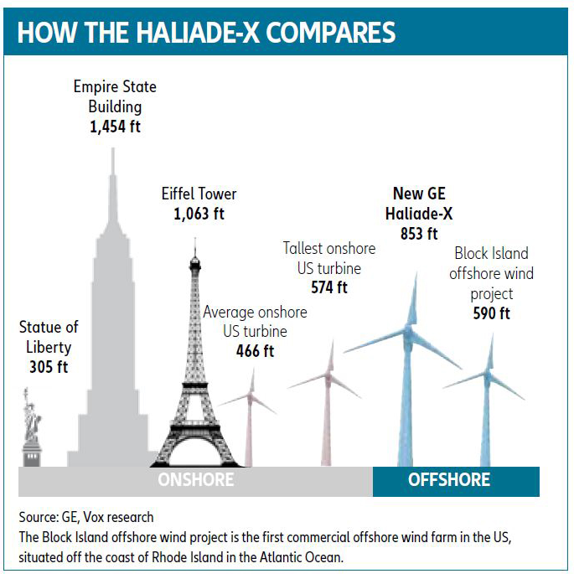
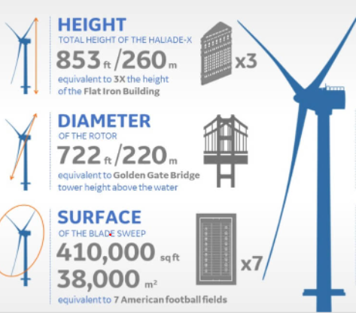
Size Comparison of OSW Turbines
GE Haliade-X 14MW
853 feet high
722 ft rotor diameter
One rotation can power one (UK) household for 2 days
67 GWh annually

Slide 11
What are the port requirements for OSW?
Vessel/Foundation depth – 35ft.
Vessel clearances – separation distance between vessels at the quay is 75ft.
Upland and Quay Acreage – 65-80 acres
Upland and Quayside loading – 3000psf upland/5000psf quay
Air Draft – Unlimited
Length of Quay – Directly related to the length of vessel and foundations.
Land Based Crane – Liebherr 11350
Distance to Installation Site – This depends, but we have seen distances of up to 780nm.

Slide 12
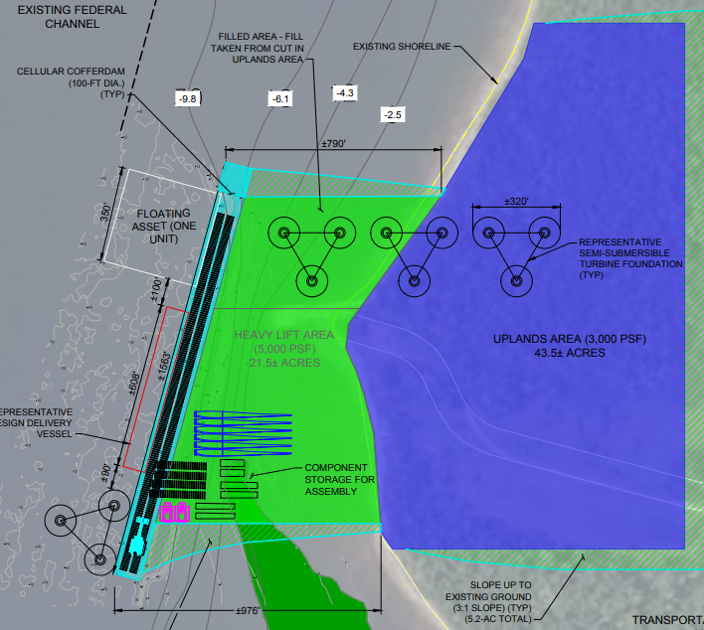
Quay Requirements

Slide 13
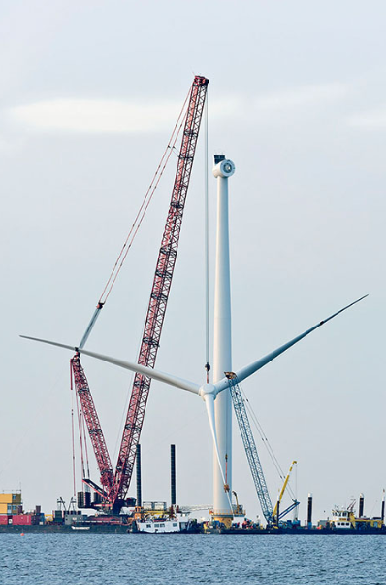
Liebherr 11350
1,350 tons lifting capacity
Max Hoist Height – 722 ft.
Max Radius – 538 ft.

Slide 14
Examples of floating OSW Port Facilities
There are currently no purpose-built floating OSW port facilities in the world.
Both Kincardine (Scotland) and Windfloat Atlantic (Portugal) used multiple facilities to fabricate foundations.
This required a significant towing distance between the ports and installation sites.
The lack of a purpose-built facility means that significant cost and time was added to the fabrication and installation process.
Kincardine Installation Video

Slide 15
Why does Maine need an OSW port?
A purpose built deep water OSW terminal will support commercialization of the OSW energy industry in Maine.
To achieve clean energy goals and combat climate change.
Become an industry leader in floating offshore wind.
Maine does not currently have a deep water port with sufficient available upland space to support the construction, operation, and maintenance of offshore wind turbines and, without it, the offshore wind industry will not be developed.

